Slide 1
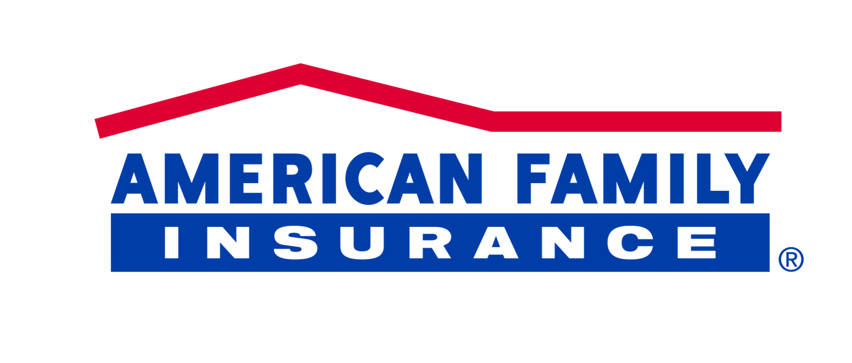
SYSTEM RELIABILITY ENGINEERING
FOR DATA AND ANLYTICS SCALE OUT

Slide 2
Agenda
American Family Insurance is building, transforming and modernizing its data analytics ecosystem with Google Cloud Platform (GCP) and other advanced technologies for building an analytics driven business. American Family has engaged NTT DATA to scale out adoption of GCP Cloud Operations rapidly to bring new analytics capabilities to their broader portion of the business and operating companies. American Family’s requirements are structured the following way:
SRE CoE as a Service
DevSecDataOps Process & Tools Framework Definition & Maintenance
DevSecDataOps pipeline usage guidelines covering process and tools
DevSecDataOps Tools Usage Guidelines
DevSecDataOps Tools Integration, Customization and Optimizations
DevSecDataOps Knowledge Repository Management
DevSecDataOps Training Framework & Delivery
Capability Snapshot
Reference Architecture
DevSecOps Practices
Value Stream Definition
Metrics, Assessment Framework

Slide 3
SRE Capability Snapshot
KPI’s Metrics & Dashboards
Platform Metrics
DevSecOps Metrics
Proj Mngt Metrics
DSDO Platform
CONFIGURATION MANAGEMENT
CONTINOUS INTEGRATION
CONTINOUS INFRA & DEPLOYMENT
CONTINOUS TESTING & DELIVERY
CONTINOUS MONITORRING
CONTINOUS Data Processing
CICD Services Catalog
Data Catalog
ML Ops Catalog
AI Ops Catalog
Advertised Quality of Service
Secure Platform Configurations
DSDO Operating Model
Monitoring
Support
Platform Access model
Culture
Metrics driven
Lean Principles
Continuous Improvement
Quality, Training
Change Champions
Branching & Merging Strategies
Knowledge Management
Scoping & Requirement
Test Case Management
Defect Management
Approved libraries, Frameworks
Unit Tests
Code Quality (Linting)
Dependency Management
Threat Modelling
Security Plugins for IDE
Pre commit security Hooks
Secure App Configuration guidelines
IoaC( Infrastructure as a code)
Automated Builds
Artifact Management
Artifact Repository Management
Dependency Analysis
SAST
DAST
Security Unit Tests
Alerts on High Risk code changes
Quality Scan
Stage Gating
Automated Deployments
IoaC Analysis
IoaC Configuration
IoaC Execution
Infra Security
Automated Security attacks
Fuzzing, Manual & Pen Tests
Compliance checks
Secrets Management
Host Intrusion
Automated Functional tests
Automated Performance Tests
Automated Integration tests
Automated Regression tests
Release Management process
Security Stage gates
Compliance & Audit gates
App Monitoring
Infra monitoring
Incident management
Alerting
Diagnostics
Security Smoke tests
Runtime Defense
Continuous Scanning
Data Lineage
Data Catalog
Reference & Integrated Data
Data Workflows
MI Ops
AI Ops
Data Quality
Raw, Curated Data Processing
Standards, Patterns & Guidelines
Risk Assessments
Secure guidelines on Communication
Continuous Compliance & security

Slide 4







SRE as a Service
Developers
3
Central Release Orchestration
ServiceNow
1
Agile Planning
Build Orchestration
Deployment Orchestration
Deployment Orchestration
CI Env
4
Dev
5
QA
6
8
Prod
2
Deployment Engines
Stage/Perf
Build Automation
Static Code
Assessment
Security
Vulnerability
Artifact Repository
Source Code Management
Audit Document Repository
7
Audit Document Repository
Dev
gate
QA gate
Stage gate
Prod gate
ServiceNow
(End to End Visibility)
1
Requirements documented in Jira & Design documented in Confluence. Test Planning is documented in Zephyr in Jira.
4
Dev lead/manager approves deployment to Dev in Gilab CI. Deployer gets notified and Automated deployments starts
7
All project/release documentation (Requirements Info form, Design Info Form, Test Plan / Test Strategy, Test Evidence (QC Test Cases, Execution results), Deployment (Deployment Plan Check list, Go Live/ Deployment Approval) will be automatically extracted and uploaded to confluence for application teams to upload to audit repository and required signoff is received
2
Developers check-in code in SCM after they utilize Sonar lint in the code and auto scan for secrets via GIT Secrets.
Peer review and approval will merge their code
5
QA lead/manager approves deployment to QA in Gitlab CI. Deployer gets notified and Automated deployments starts
3
Code merge to release/dev branch will trigger an automated Cloud bees workflow. Deployer will start the release in CJB. Build happens automatically via Jenkins. Automated Quality scans to validate builds. Predefined security scans as required. Deployable binaries are automatically stored in Artifactory and Ansible/CJB will deploy on CI Env to validate deployment
6
Systems team lead/manager from product teams approves deployment to Stage/Perf. Deployer gets notified and automated deployments starts
8
Application Team (Systems lead or product manager) opens a Service now change ticket and gathers required approvals to start deployment. Deployer will trigger or schedule automatic deployment

Slide 5
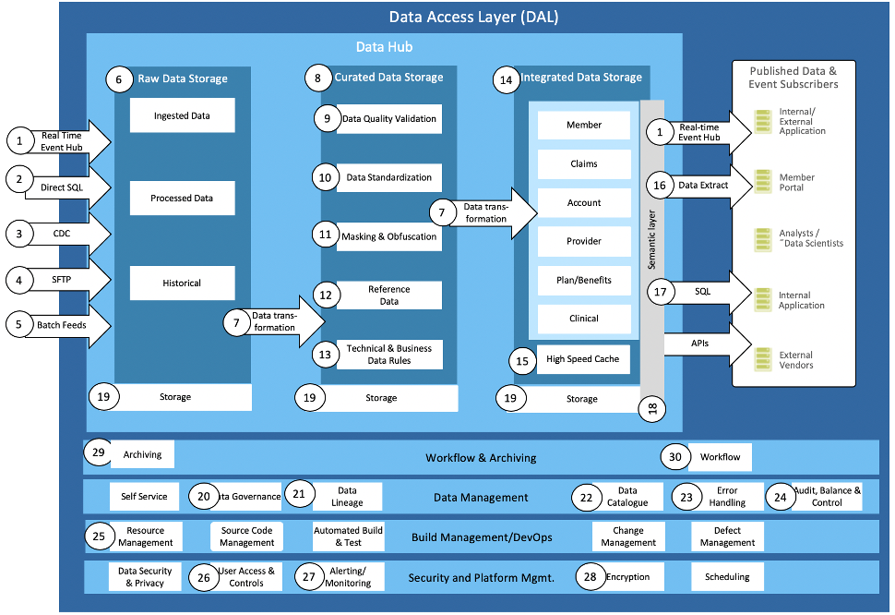
Data Definition Pipeline
Kubernetes is an opensource cloud platform from Google and sponsored by the Cloud Native Computing Foundation
•Kubernetes is a container runtime and it is mostly used to run docker containers. There are several solutions that offer a PaaS experience on top of Kubernetes, such as Google Infrastructure.
•Solutionusetheideaofcontainerstoisolateyourapplicationfromtherestofthesystem
•Kubernetesisdesignedtoruneitheronpubliccloudinfrastructureoron-prem
•Solution offer the ability to running hybrid/multi-cloud environments
•Not a traditional, all-inclusive PaaS
•WithKubernetes,youneedtodefinethetemplateforthisdockerimageyourselfinaDockerfile
•Kubernetes, uses a command line interface called “kubectlcli”
•Kubernetessupporttheabilitytodeployapplicationswithzerodowntime,thisisoneareawhereKubernetesoutperformsCloudFoundry
•Each of the components should be developed and managed separately.
•Wellsuitedforapplicationcontainerization,caneasilymoveon-permapplicationstocloudbasedsolution.

Slide 6
Flexible Options to cater all the areas
Private
Software as a Service (SaaS)
Operated for a single organization
Can be managed internally (on premise) or by a third-party (hosted)
Single Tenant
Delivering software / application functionalities
Platform as a Service (PaaS)
Delivering complete platform (e.g., operating system, database, and web server)
Hybrid
Infrastructure as a Service (IaaS)
Two or more clouds that are bound
Benefit of multiple deployment models
Delivering infrastructure (e.g.,servers,storageandnetworking)from the Internet in a pay-as-you-go model
▪Ex:AmazonWebServices, GoogleCompute,IBMCloud, MicrosoftAzure

Slide 7


Configuration Management
 |  |  | Configuration management
 |  |  | People | Process | Technology
Knowledge Management , Scope & Requirement |  |  | Developers & Engineers Product Owners Scrum masters | Training & Regular updates Story Life cycle ( Do’s & Don'ts) Updating Design on a regular basis Continuous Improvement mind set
Test Case Management, Defect Life cycle, |  |  | ScrumMasters Product Owners Team’s – Developers/ Testers | Full transparency and visibility embedded into projects in a consistent story updates Regularized review of test planning at Feature & Story levels Defect management Process automated and Triage visualization.
Approved Libraries, Frameworks, Unit Testing, Quality (Linting) |  |  | Developers & Engineers Enterprise Security Architecture Leads DevSecOps CoE | Day to Day Architectural & Security Handhold Simply development by Automation Approved Linting, Pre-commit declaration validations
Security App guidelines, Security Plugins, Pre-Commit Validations |  |  | Architecture Leads Engineering Leads Enterprise Security | Defined set of guidelines Enable guidelines by Quality/ Security assessments via Linting and Pull request declarations Pull request Validations before Approval process based on Branching Strategy
IaC, Dependency Management |  |  | Infrastructure DevSecOps CoE Enterprise Security | Infrastructure teams to automate environment provision Middleware dependencies managed via automation Periodic Reviews of dependencies and Infrastructure dependencies
Threat Modelling |  |  | DevSecOps CoE Enterprise Security Enterprise Architecture | Penetration testing , Security Testing Fault Ingestion Validation Secret/ Vault Management – Rotation on a frequency
Note: Few tools are still in assessment phase and will be finalized with teams before implementing the pipeline

Slide 8

Continuous Integration
 |  |  | CONTINOUS INTEGRATION
 |  |  | People | Process | Technology
Automated Builds, Dependency Analysis |  |  | Developers & Engineers DevSecOps CoE Architecture Leads | Development Validation Builds Pipeline Builds End to end release management process Continuous Improvement mind set
Artifactory Repository Management, Artifact Management |  |  | ScrumMasters Product Owners Team’s – Developers/ Testers | Semantic Versioning management Artifacts by Versioning Archival & Purging policies
SAST, DAST |  |  | Developers & Engineers Enterprise Security Architecture Leads DevSecOps CoE | Static Scanning & Portfolio setup Static scanning in the pipeline Dynamic Scanning
Security tests |  |  | DevSecOps CoE Engineering Leads Enterprise Security | Identified Security tests in the pipeline Infra Testing Compliance checks
Quality Scans |  |  | Infrastructure DevSecOps CoE Enterprise Security | Quality Profiles Quality gates Portfolio management – Maturity Modelling
Stage Gating |  |  | DevSecOps CoE Enterprise Security Enterprise Architecture | Quality Gating in Pipeline Security Gating in Pipeline Compliance gates for appropriate Release/Change Management process Secret/ Vault Management – Rotation on a frequency
Note: Few tools are still in assessment phase and will be finalized with teams before implementing the pipeline

Slide 9
CONTINUOUS INFRA & DEPLOYMENT
 |  |  | CONTINOUS INFRA & DEPLOYMENT
 |  |  | People | Process | Technology
Automated Deployments |  |  | Infrastructure DevSecOps CoE Engineers | Deployment Validation Builds Automated Pipeline Deployment End to end release management process Continuous Improvement mind set
IoaC Analysis, Config, Execution |  |  | Application Owners Infrastructure DevSecOps CoE | Infrastructure as a code Automated provisioning
Infra Security |  |  | Infrastructure Enterprise Security DevSecOps CoE | Compliance Checks Dedicated Accounts setup Integrated security with Vault management
Automated Security attacks, Manual Pen tests |  |  | Application Owners Engineering Leads Enterprise Security | Identified Security tests manually before change management Manual pen tests Veracode intrusion tests
Compliance Checks |  |  | DevSecOps CoE Enterprise Security Application Owners | Periodic Reviews Regular Audit by Product teams Automated Compliance checks by SOD , Change Rules
Secrets Management & Past Intrusion |  |  | DevSecOps CoE Enterprise Security Enterprise Architecture | Vault Management Pipeline Automation Security Gating in Pipeline Secret/ Vault Management – Rotation on a frequency
Note: Few tools are still in assessment phase and will be finalized with teams before implementing the pipeline
Continous Deployment

Slide 10
CONTINOUS TESTING & DELIVERY
 |  |  | CONTINOUS TESTING & DELIVERY
 |  |  | People | Process | Technology
Automated Functional Tests |  |  | Testers – Engineers DevSecOps CoE Test Scrum Masters | Automated Test cases management Automated Pipeline Execution New Use identification scripting process Continuous Improvement mind set
Automated Performance Tests |  |  | Application Owners Infrastructure DevSecOps CoE | Continuous Performance execution Automated pipeline execution Automated Sla management
Automated Integration, Regression tests |  |  | Infrastructure Enterprise Security DevSecOps CoE | Automated Test cases management Automated Pipeline Execution New Use identification scripting process Continuous Improvement mind set
Release Management |  |  | Application Owners Engineering Leads Enterprise Security | Automated Release management orchestration Automated change process Evidence capture automation
Security Stage Gates |  |  | DevSecOps CoE Enterprise Security Application Owners | Security Validation & Pipeline automation Automated Stage gate failures
Compliance & Audit gates |  |  | DevSecOps CoE Enterprise Security Enterprise Architecture | Pipeline Automation for compliance checks Compliance reporting
Note: Few tools are still in assessment phase and will be finalized with teams before implementing the pipeline
Continous Testing

Slide 11
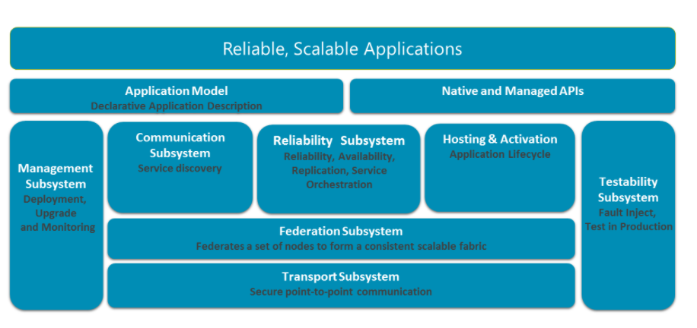
CONTINOUS TESTING & DELIVERY
Establish a project to look at container based service infrastructure. Containers enable faster deliver then VM and will enable a faster pace of change for many of the day to day activities in the development cycle. There are many platforms available that can speed up and reduce the complexity to a more complex application infrastructure.
The projects should establish a road map to establish the correct platform, development practices and operations model.
Operation Model
Cloud ( AwS, Google) virtual infrastructure

Slide 12
CONTINUOUS MONITORING
 |  |  | CONTINOUS MONITORRING
 |  |  | People | Process | Technology
App Monitoring |  |  | ALL Application Owners DevSecOps CoE | Application Logs Dashboards Reports Scheduled
Infra Monitoring |  |  | Application Owners Infrastructure DevSecOps CoE | Critical parameters monitoring Automated alerts & Dashboards Automated Sla management
Incident Management |  |  | Application Owners Enterprise Release DevSecOps CoE | Incident creation for alerts
Alerting & Diagnostics |  |  | Application Owners Engineering Leads DevSecOps CoE | Alerts Incidents via Alerts
Runtime Defense |  |  | DevSecOps CoE Enterprise Security Application Owners | Security Validation & Pipeline automation Automated Stage gate failures
Continuous Scanning |  |  | DevSecOps CoE Enterprise Security Compliance Teams | Compliance reporting
Note: Few tools are still in assessment phase and will be finalized with teams before implementing the pipeline

Slide 13
Onboarding Model
What is DSDO-CoE Onboarding Strategy
Provide Architectural Assessment
Leverage NTT DATA’s Digital expertise for Solution Assessment
Microservices, API based design expertise from AmFam Digital Technology to accelerate the solution design
01
Deploy a high performing scrum teams with execution capabilities in an onshore-offshore model
Detailed Architectural Future State
02
Future State Architecture
Delivery model includes experienced global resources with execution capabilities organized into multiple scrum teams (scrum of scrums)
Accelerate delivery performance with tools that improve team capabilities to reach Future State
03
Architectural Roadmap
Architectural, Reliablity Engineering guidance throughout the lifecycle
Engineering leadership aligned with guidelines
04
Thought Leadership
Process Definition's on the Framework and enable application teams
Self Serve
Application team to comply to Framework governance approved by guidelines
05
Implement & Govern

Slide 14
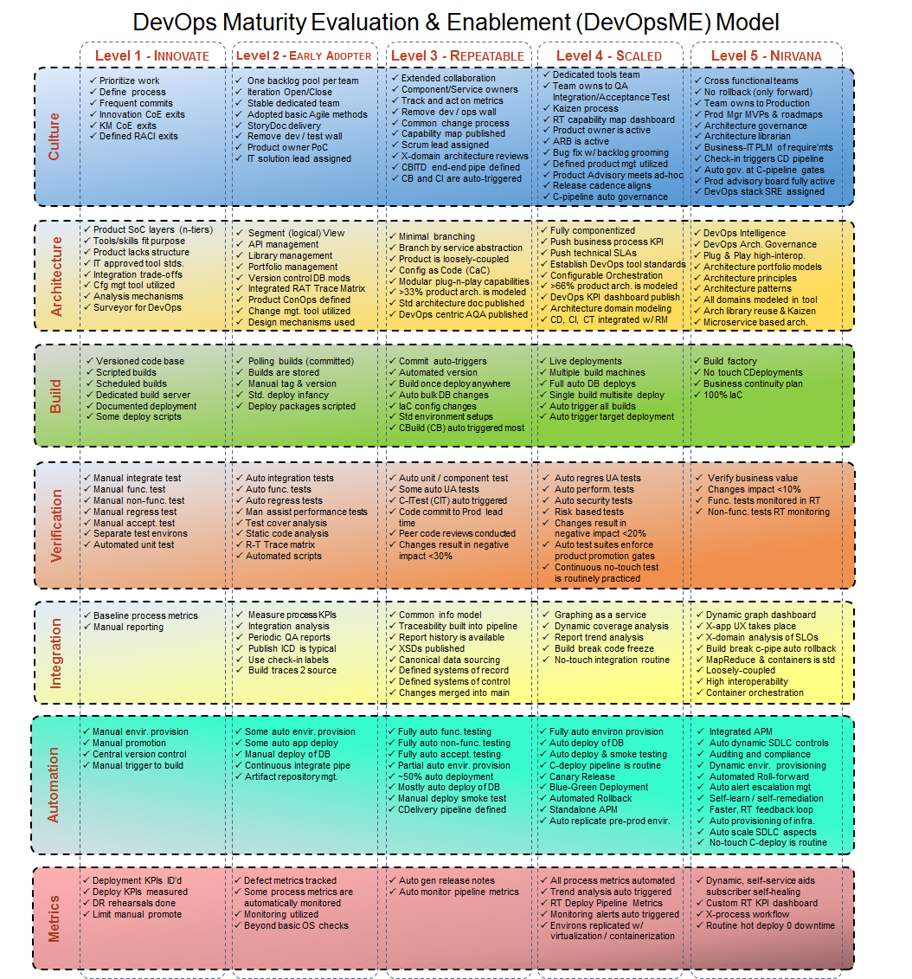
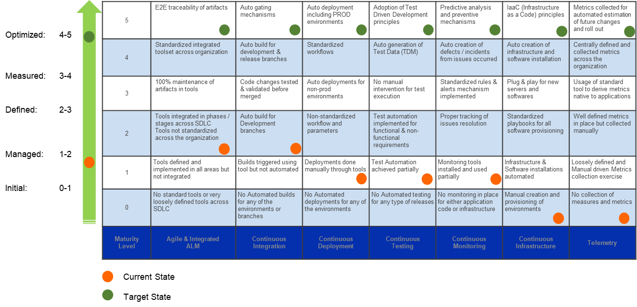
Assessment Framework

Slide 15
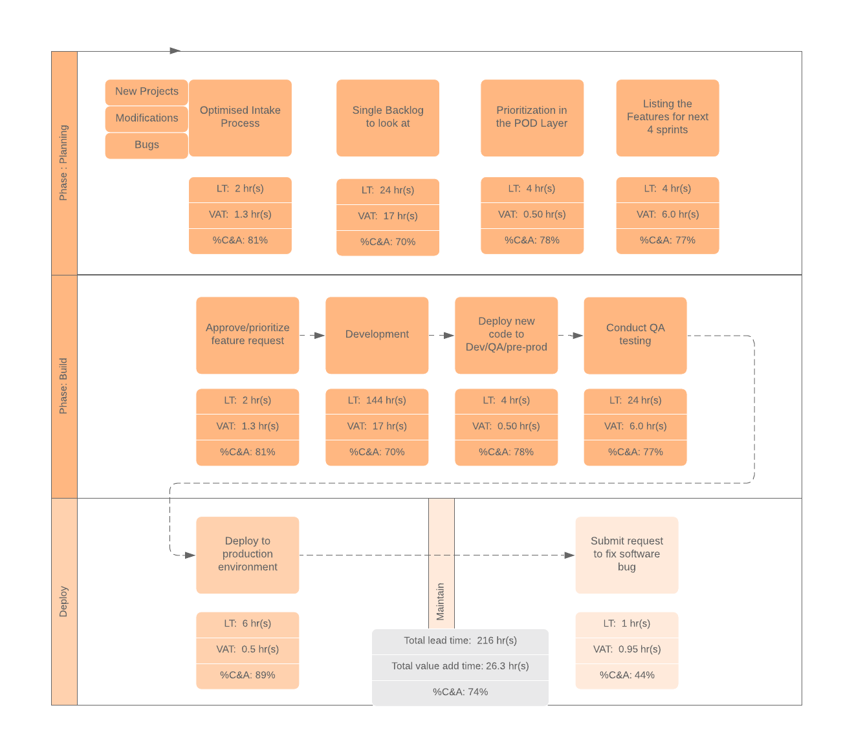
Evaluate Value Stream Mapping – Illustrative
Understand AS-IS Process to identify TO – Be Process Improvements
Intake Process
Automated Intake Process via Jira ( POD Layer to create the Features
Designs been documented for the feature by Architect in Confluence and linked
Prioritized Features are available for Feature Grooming to build stories
Test Planning – Test Cases reviewed from BA’s – Jira itself ( backward compatibility to ALM for Audit purposes
Automated Build & Deployment
Enable Developer to trigger development releases to minimize wait time
Automated Test – Smoke tests, Unit Tests, Regression tests
Test Evidence – updated into Jira Feature- Story – Backward ported between Jira – ALM .
Defect is created in Jira with an Issue Type as Bug in the Release cycle under the story/ feature for traceability.
Automated Change management process integrated with SNOW from Jira and Pipeline to validate the approvals
Stage Gates for environment deployments
Infrastructure teams to debug the environment issues
Test Data Management -- Test Data creation is by Test team – Scripts to be placed in Gitlab to utilize in the pipelines for testing pipelines
Monitoring Tool :- Over arching monitoring tool – Custom Dashboard for visualization and error alerts.
Total Value time saved will be more than 74%
Automated scans will enable Quality
Automated build & Deployment will reduce the wait time by 86%
Automated testing pipelines will reduce more than 65% time consumption

Slide 16
High Level Metrics - Governance
High Level Metrics
Detailed Metrics
Value
Deployment frequency
Reduced Cost
Deployment Frequency
Application availability
Mean Time To Recovery
Mean Time To Detection
Improved Quality
Environment availability
Mean Lead Time
Customer satisfaction
Lead time for provisioning
Reduced Time to Market
Cost per release / Sprint
Lead time development to deployment
Improved Security
Change Failure Rate
Defect escape rate
Change volume
Feature usage percentage
Increased Compliance
Mean Time To Recover
Test coverage percentage
Failed deployments
Improved Predictability
Test automation percentage

Slide 17
Continuous Monitoring Selection Criteria Illustrated
 | Option 1 | Option 2 | Option 3 | Option 4
 | ELK Stack | Sumo Logic | Data Dog | Splunk
Description/ Plan | AWS & on-premise | Procure licenses for just enough users | Procure licenses for just enough users | Free option Microsoft App from Microsoft Store Collaboration with Office 365
Licensing
Licensing costs
Paid licenses needed only for | Platform, API, Misc | Facilitator | Facilitator | NA
Security, Compliance, Governance
Single Sign On, IAM , Others | No | Yes | Yes | Yes
Central Administration | No | No | Yes | Yes
Centralized Insights | No | No | Yes | Yes
Mobile App Management | No | Yes | Yes | Yes
Private, Encrypted Data Store | No | No | Yes | Yes
Functionality
Log Aggregation
Log Setup | Yes | Yes | Yes | Yes (by Size)
Template selection variety | High | High | High | High
Custom Parsing & Event recycling | No | No | Medium | High
Alerting & Monitoring
Alerting & Integration | Yes | Yes | Yes | High
Dashboards & reports | Yes | Yes | Yes | High
Intrusion Prevention System. Via AppD
APM | Yes | Yes | Yes | High
Costs Monitoring | Yes | Yes | Yes | High
Monitoring as code | Yes | Yes | Yes | High

Slide 18
Architectural Roadmap
Reliability
Q1
Q2
Q3
Q4
Self Service Process Map
Asset Warehouse
Self Service
Automation
Velocity
Self Service
Portal
Governance
Service
Catalog
DevSecOps Portal
Developer Portal
Foundation Platform
Observability
Foundation/ Design
Build & Implement
DevOps
Dashboard/ Alert
Metrics
Identify Critical Metrics
Build & Implement
Reliability
Dashboard
Scalability
Container
Strategy
Container
Readiness
Container
Implementation
Architecture
Infrastructure
DevOps
Build

Slide 19
Pod Details: SRE “Shark”

Slide 20
SRE - Transformation Journey
SRE transformation follows a highly collaborative three-phased approach: Engage, Execute, and Evolve
Engage
Execute
Evolve
Analyze service design
Assess incident data
Conduct gap analysis
Identify value streams
Establish metrics strategy
Define/Refine processes, procedures, checklists, etc.
Automation is a priority
Monitor for dependencies and integration gaps
Metrics data collection, threshold baselining
Operationalize all activities
Conduct system and solution increment reviews
Measure and report SLA’s
Drive continuous improvements
Assessment Report
Reliability Specification
CoE Engagement
Checklists
Playbooks
CoE Engagement
Standard Operating Procedures
Metrics Dashboard
CoE Engagement
Sprint 1-2
Sprint 3-4
Sprint 4-5
NOTE: Due diligence that was conducted by American Family has already established a preliminary SRE work item backlog, which will be used to jump-start the SRE onboarding and accelerate the “Engage” phase.

Slide 21
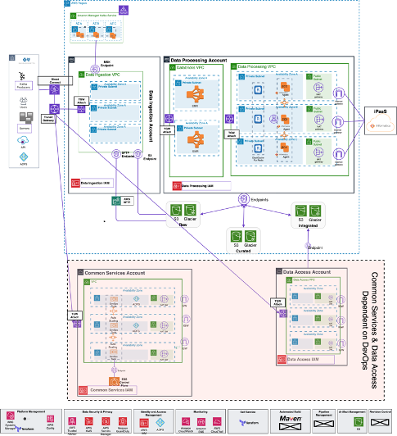
Exemplar AwS Environment

Slide 22
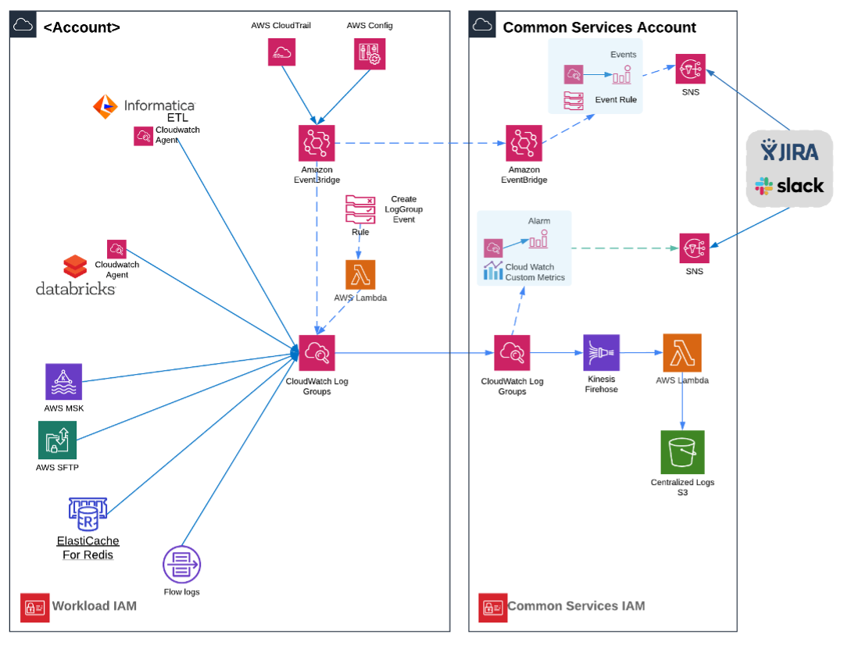
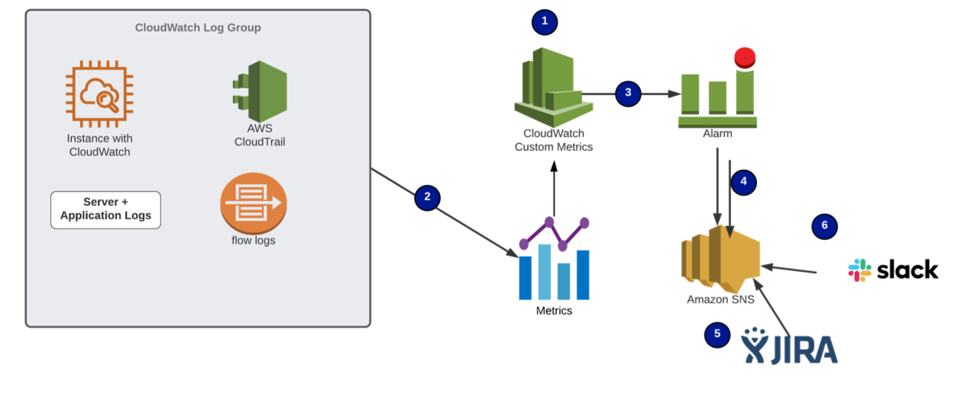
Exemplar AwS Environment

Slide 24
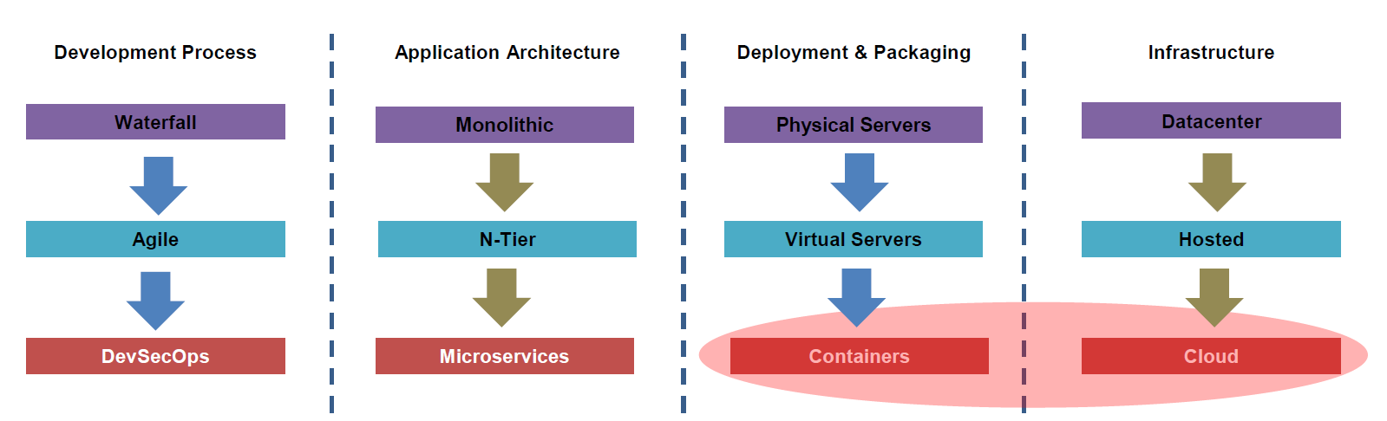
Digital Re-invention
Cloud Target Operating Model (CTOM)
Demand Servicing Agility
Demand Servicing Agility
Organization
Governance Model –Policy, Decisions
Organizational Model
Financial and Performance Model
Performance Metrics
Services Portfolio ‘Menu’
Service KPI Model –SLAs, OLAs
Platforms and Technologies
Methods & Tooling
Sourcing Model Locations, Facilities, Assets, Contracts, Capacity
Process, Standards, Methods
Automation Tooling
Container Adoption
Agility
DevOps for continuous improvement
Culture, Leadership and Change
Digital Technology & Services Strategy
Service Product Introduction & Change
Talent & Knowledge Strategy
Continuous Release Lifecycle Management
Continuous Release Lifecycle Management
Service Architecture and Design
Configuration & Version Management
API & Integration Management
Release Testing & Integration QA
Automated Fulfilment & Provisioning
Automated Fulfilment & Provisioning
Service Access & Orchestration
Platform Environment Provisioning
Availability & Service Reliability Engineering
Application & Data Provisioning
Continuous Service Operation
Continuous Service Operation
Platform Performance Management
Services & API Event Monitoring
Security & Business Continuity

Slide 25
OFI # Metrics

